Slide 1
DISTRIBUTED SYSTEMS Principles and Paradigms Third Edition MAARTEN VAN STEEN ANDREW S. TANENBAUM Chapter 3 Processes

Slide 2
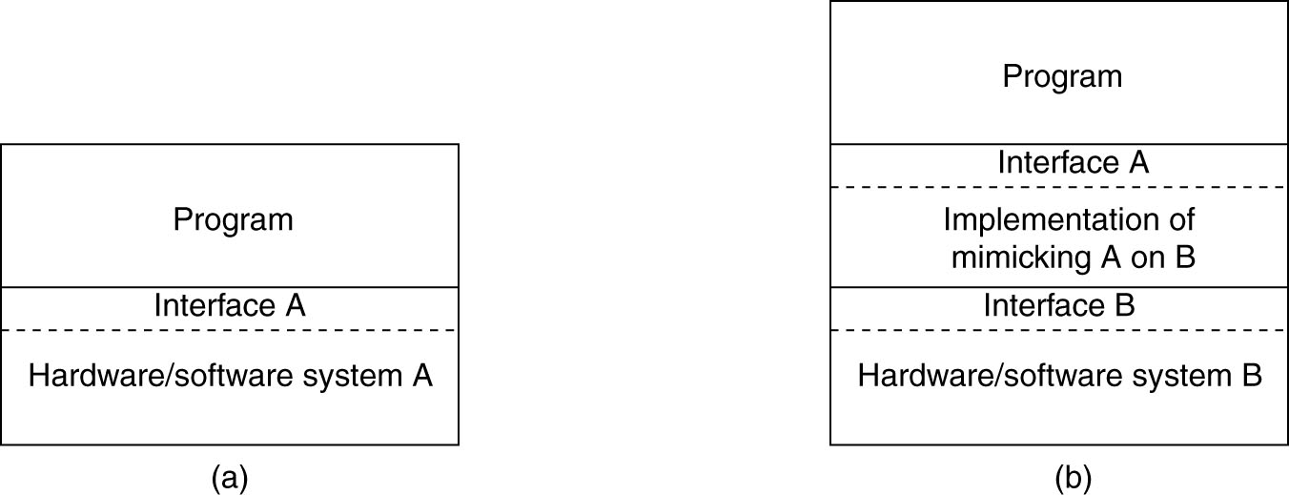
The Role of Virtualization in Distributed Systems
Figure 3-5. (a) General organization between a program, interface, and system. (b) General organization of virtualizing system A on top of system B.

Slide 3
Architectures of Virtual Machines
Interfaces at different levels:
[A] An interface consisting of library calls generally forming what is known as an application programming interface (API).
[B] An interface consisting of system calls (SVCs—supervisor calls) as offered by an operating system. In many cases, the system calls are hidden by the API. Example: API for socket programming—the network system calls are hidden deep in the library code.
https://www.elprocus.com/virtual-machine/ Thanks Kajal!

Slide 4
[C] An interface between the hardware and software consisting of machine instructions (part of the architecture / represented in assembly language code).
that can be invoked by any program. User instructions
that can be invoked only by privileged (root) programs, such as an operating system. Root instructions

Slide 5
Why do we bother with root instructions?
Users can damage hardware—imagine sending a disk actuator arm back and forth across the disk at high speed for three days.
Users don’t want to have to learn the details of hardware manipulation in driver code, for example: Set pin 23 high, except when patch AA345982-12 has been applied in a coax environment on a pre-2017 B37 Samsung chip, in which case set pin 23 low and pin 87 high…

Slide 6
For these reasons and others, manipulate the hardware with privileged (root) instructions.
User processes use SVCs (operating system library calls) to ask the operating system to perform hardware operations on their behalf: please open this file for me, please write on the monitor for me, please give me more memory for my linked list…
A context switch to root takes place to temporarily give the system library code time to execute the call. Then control is returned to the user process. Context switches are also used to switch from running one user process (A) to running another user process (B).

Slide 7
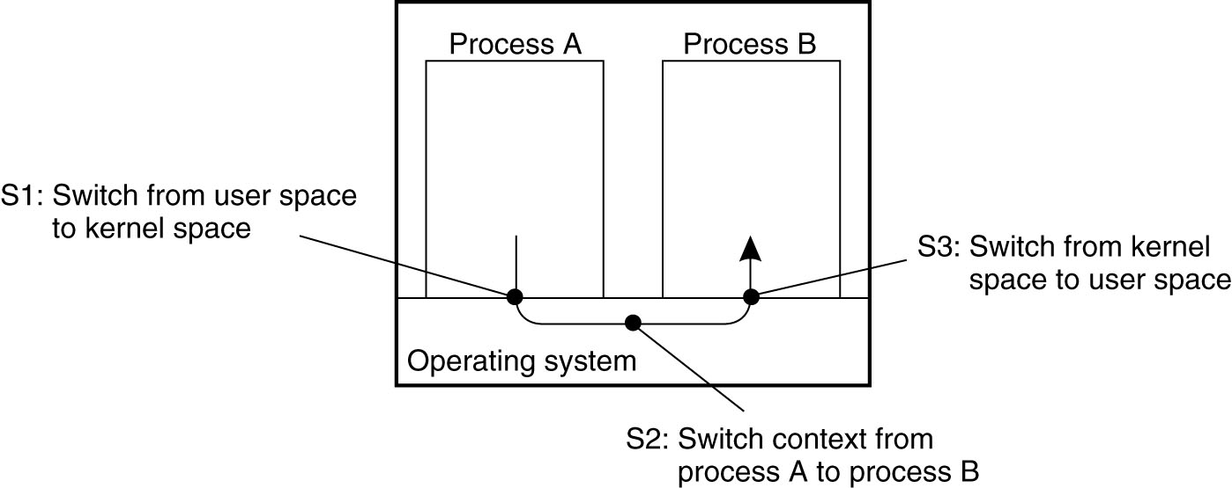
Thread Usage in Nondistributed Systems
Figure 3-1. Context switching as the result of IPC.

Slide 8
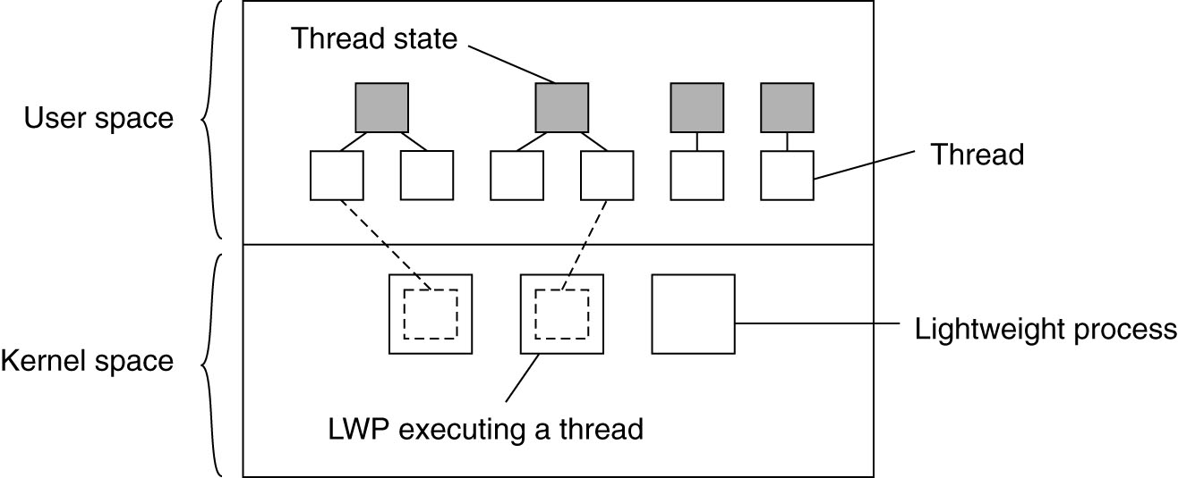
Thread Implementation
Figure 3-2. Combining kernel-level lightweight processes and user-level threads.

Slide 9
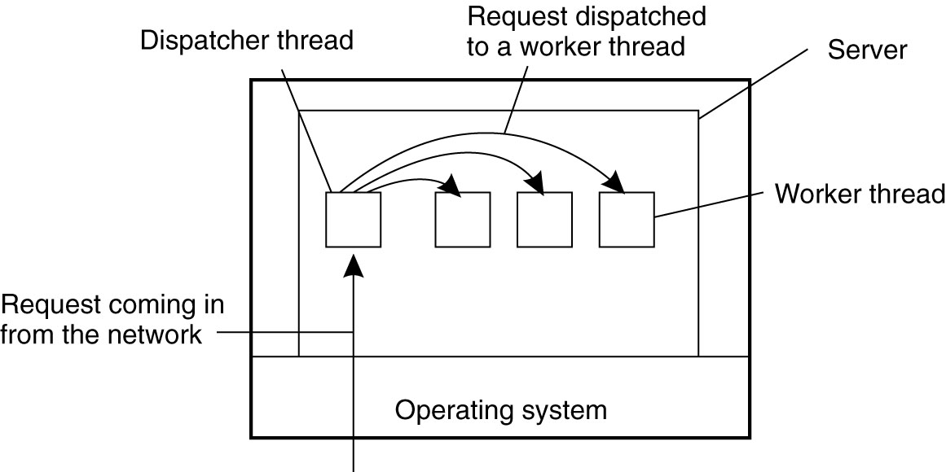
Multithreaded Servers (1)
Figure 3-3. A multithreaded server organized in a dispatcher/worker model.

Slide 10
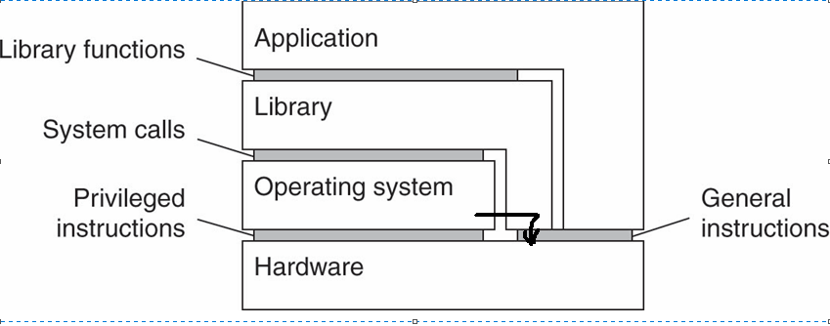
Architectures of Virtual Machines
Figure 3-6. Various interfaces offered by computer systems.

Slide 11
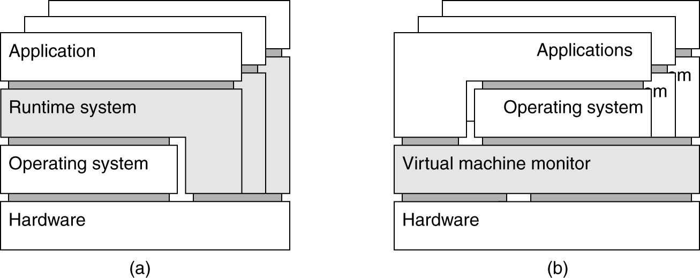
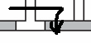
Architectures of Virtual Machines (4)
Figure 3-7. (a) A process virtual machine, with multiple instances of (application, runtime) combinations.

Slide 12
Architectures of Virtual Machines (5)
Figure 3-7. (b) A virtual machine monitor, with multiple instances
of (applications, operating system) combinations.

Slide 13
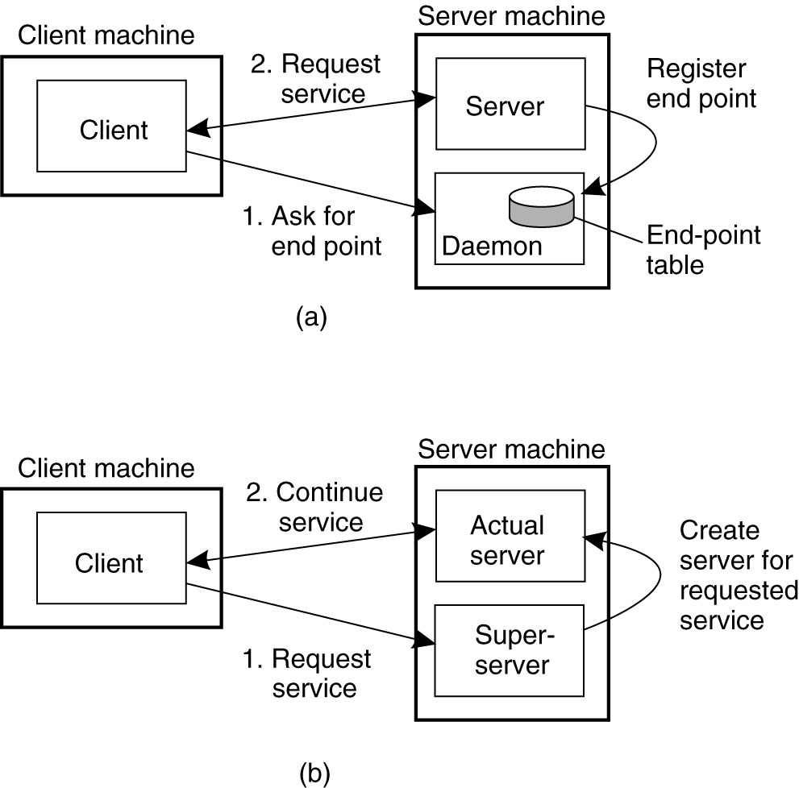
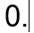
Daemons / Nameservers
Figure 3-11. (a) Client-to-server binding using a nameserver daemon.

Slide 14
Superservers
Figure 3-11. (b) Client-to-server binding using a superserver.

Slide 15
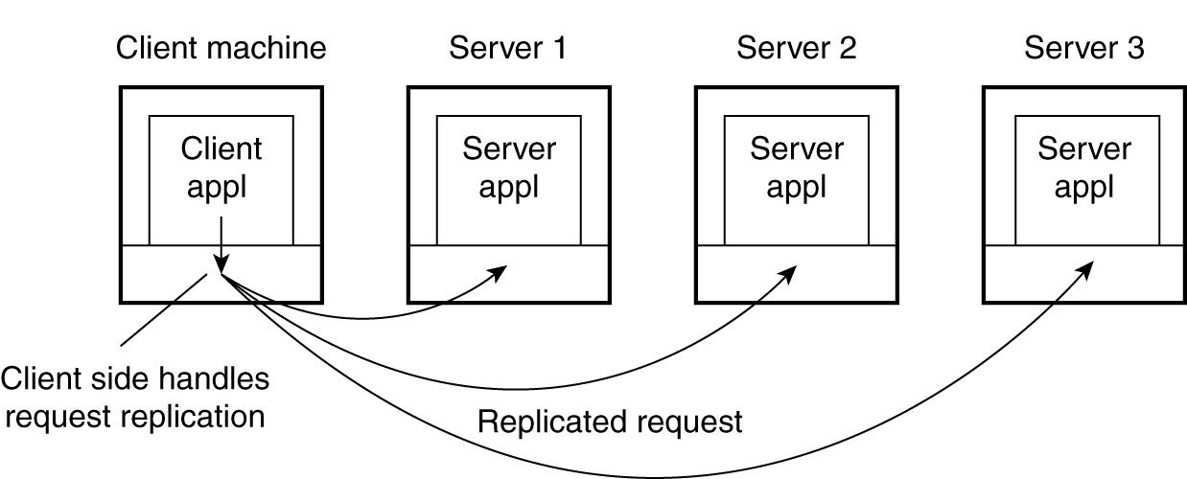
Client-Side Software for Distribution Transparency
Figure 3-10. Transparent replication of a server using a client-side solution.

Slide 16
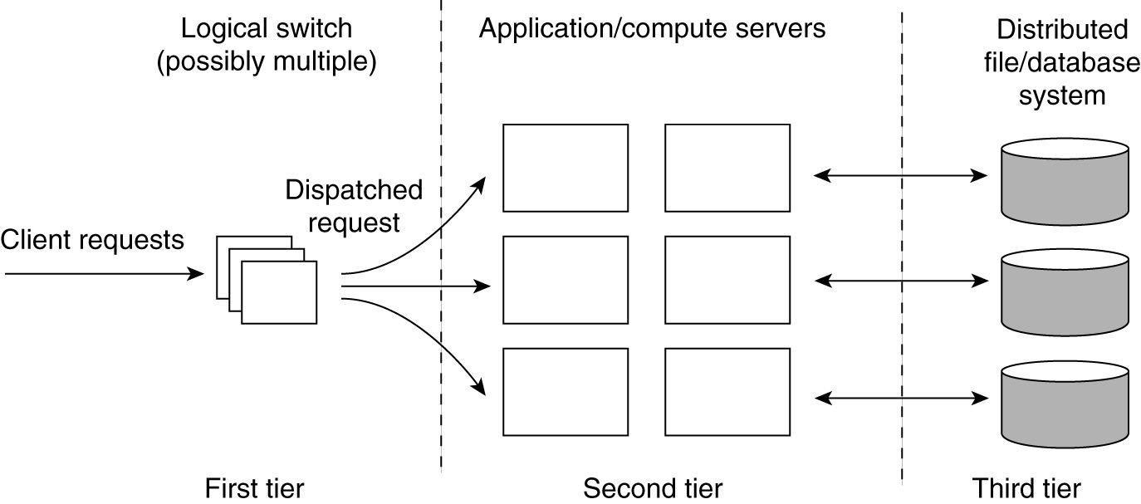
Server Clusters (1)
Figure 3-12. The general organization of a three-tiered server cluster.

Slide 17
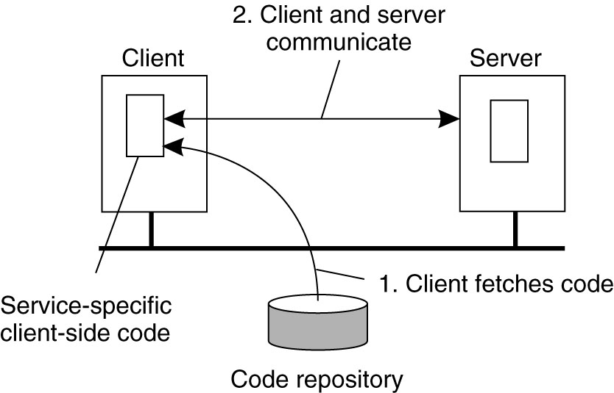
Reasons for Migrating Code
Figure 3-17. The principle of dynamically configuring a client to communicate to a server. The client first fetches the necessary software, and then invokes the server.

Slide 18
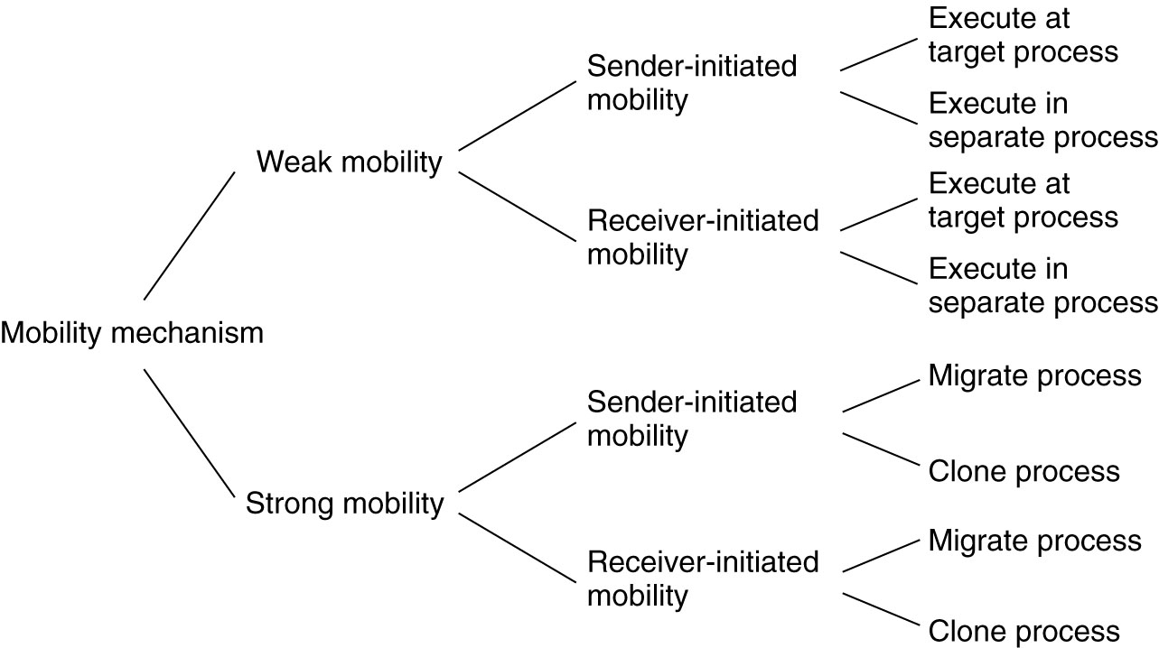
Models for Code Migration
Figure 3-18. Alternatives for code migration.

Slide 19
Migration: process-to-resource binding
Copyright 2020 Clark Elliott
By identifier – Strongest – URL, Internet address. The absolute name. Thus the absolute thing.
By value – such as standard libraries. Copy of the library is fine.
By type – weakest – reference to “some terminal” or “some printer”

Slide 20
Migration – Can resource be moved?
Unattached resource—such as data file specific to the application (so just move it)
Fastened resource—could be moved theoretically, but not practical. Complete web site, local database used by others.
Fixed resource – cannot be moved. E.g., real IP address / end point.
Copyright 2020 Clark Elliott

Slide 21
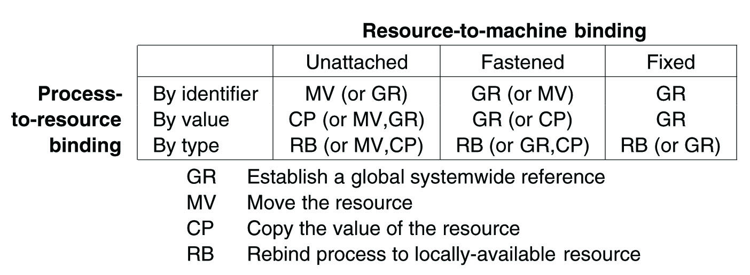
Migration and Local Resources
Figure 3-19. Actions to be taken with respect to the references to local resources when migrating code to another machine.

Slide 22

Table of resource migration strategies
Add to your toolbox
Know that such a table exists, and can help develop a strategy for migrating resources.
Might constrain preliminary blue-sky design
What are the categories of your resources?
Copyright 2020 Clark Elliott

Slide 23
Migration in Heterogeneous Systems
Three ways to handle migration (which can be combined)
Pushing memory pages to the new machine and resending the ones that are later modified during the migration process.
Stopping the current virtual machine; migrate memory, and start the new virtual machine.
Letting the new virtual machine pull in new pages as needed, that is, let processes start on the new virtual machine immediately and copy memory pages on demand.

Slide 24
Migration in Heterogeneous Systems
For large-scale system design these could be important
The possibility of migrating code, including in real time
The concepts of resource types and process-to-resource binding types for processes that migrate—how do you design for these?
The compromises of Push, Pull and Stop of a process when migrating in real time.
So add the general concepts to your toolbox!

Slide 25
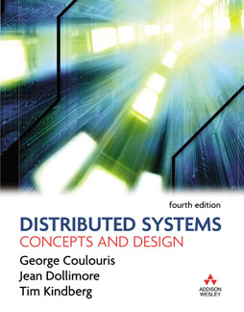
Figure Slides for Chapter 4: Networking and Internetworking
From Coulouris, Dollimore and Kindberg Distributed Systems: Concepts and Design
Edition 4, © Pearson Education 2005

Slide 26
CDK Slides
Copyright 2020 Clark Elliott
Slides prepared by…
Professor Clark Elliott
DePaul University
Some slides may be courtesy of Mark Goetsch
DePaul University

Slide 27
Overview
Copyright 2020 Clark Elliott
Introduction to inter-process communication (IPC)
API for Internet protocols
External data representation and marshalling.
Client/server communication. Request/reply protocols.
Group communication

Slide 28
Figure 4.1 Middleware layers

Slide 29
API for Internet Protocol
Copyright 2020 Clark Elliott
From the programmer’s point of view:
UDP – pass a single message from from one process to another. Datagrams
TCP – create a two-way stream between processes. Foundation for producer/consumer communication.

Slide 30
Synchronous vs. Ansychronous Calls
Copyright 2020 Clark Elliott
Fundamental to understanding DSes.
Synchronous calls are like procedure calls in a program, caller waits for the return.
Asynchronous (that is, not-synchronous) calls are entirely different and require a whole new programming paradigm. Many variations. All release the caller at some point, so there is less waiting. All require re-establishing contact with the caller.

Slide 31
Synchronous calls
Copyright 2020 Clark Elliott
Caller initiates contact with the receiver, sends request/call/data and waits until the receiver returns a response, then continues.
Caller is blocked and can do nothing until the return.
Easy to code and to understand
Only one style
Inefficient
Caller may hang on bad receiver

Slide 32
Asynchronous Calls
Caller sends request/call/data and then proceeds to useful local work without waiting.
Caller must then be interruptable, that is, drop everything and process the return, when the response comes. This is complicated to program.
More efficient
More complex
Many variations, depending where you synchronize
Caller will not hang
Copyright 2020 Clark Elliott

Slide 33
Write your own async. call
Copyright 2020 Clark Elliott
Because of the complexity of responding to an asynchronous response, this is left to the application programmer.
Multiple threads in one process allow a blocking call—where one thread waits for the response—to effect asynchronous calls.
Threads are synchronized as needed.
Imagine INET client as asynchronous

Slide 34
IP header quadrad uniquely identifies the conversation to the Internet.
Copyright 2020 Clark Elliott
IP address and port number of sender
IP address and port number of receiver
Both IP addresses are known, and the recipient’s port number is known.
Usually use the get-next-available-port() system call to find a spare port on the sender for the fourth value—we don’t care where it is. The recipient will read the value and send responses back to that port. When finished, give the port resources back to the operating system.

Slide 35
Sending
Copyright 2020 Clark Elliott
Usually use get-next-available-port() call to find a spare port and send with that. E.g. 58685, 61361, 61362, 61364
Look at your connections: Netstat
TCP 192.168.1.201:58685 […] ESTABLISHED
TCP 192.168.1.201:61361 […] TIME_WAIT
TCP 192.168.1.201:61362 […] TIME_WAIT
TCP 192.168.1.201:61364 […] ESTABLISHED

Slide 36
Binding to a server, variations
Copyright 2020 Clark Elliott
Always use a fixed port (e.g. http)
Client refers to service by name and a name server or super server translates the name into a port number at run-time.
Allows servers to migrate as needed. Tradeoff: take on more complexity to get more flexibility.

Slide 37
Ports
Copyright 2020 Clark Elliott
Can be fixed, e.g. http, ftp, etc.
Only loosely coupled to processes, so multiple ports in and out can be used.
Allows use of “throw away” ports as needed – e.g. client send in http.
Easy to manage in application tables – just a number for an argument-slot in the API. Port identifiers are usually just integers so very easy to manipulate in arrays.

Slide 38
Figure 4.2 Sockets and ports
any port
agreed port
socket
socket
message
client
server
other ports
Internet address = 138.37.94.248
Internet address = 138.37.88.249

Slide 39
UDP
Universal Datagram Protocol
No ack, no resend, no guarantee; cheap!
Receive method returns address and port of sender, as well as the data.
Receiver block, sender non-block is usual
Datagrams arrive on receive port from any sender, in any order, is usual but…
Can form connection between processes
Copyright 2020 Clark Elliott

Slide 40
UDP “failures”
Copyright 2020 Clark Elliott
Omissions can occur—packets don’t arrive at the destination
Datagrams can arrive out of order (and also mixed in with those of other conversations)
Note: no duplication errors because not resend except by the application
Cheap because:
No state stored at source / destination
No extra messages transmitted (ack/syn)
Less latency b/c no setup

Slide 41
UDP
Copyright 2020 Clark Elliott
Cheap, fast, efficient
May be all you need
Can construct just the features you need
Add to your toolbox!

Slide 42
ServerSocket
Copyright 2020 Clark Elliott
ServerSocket (doorbell socket) blocks while listening for requests, result of request is a Socket, and ServerSocket goes back to listening.
Queue size – drop simultaneous requests for a worker if full

Slide 43
Socket
Copyright 2020 Clark Elliott
Used by pair of processes with a connection.
Construction creates a local socket and port, and also connects to remote
Throws unknown host, I/O, exceptions
Provides getInputStream and getOutputStream

Slide 44
Computer Architecture Definition for Distributed Systems
Copyright 2020 Clark Elliott
The instruction set. Each instruction has a unique bit string in the instruction register
The data arguments to the instructions, specified as bit strings in CPU registers.
The semantics of the instructions of the instructions and data arguments.

Slide 45
ADD example
Copyright 2020 Clark Elliott
ADD R1 R2 R3 ← Assembly language: add the contents of Register 1 to Register 2 and put the results in Register 3
0100 0001 0010 0011 ← bit strings in Instruction Register, Arg1, Arg2 and Arg3

Slide 46
ADD example two
Different chipsets have different architectures.
ADD R1 R2 R3 ← Assembly language: add the contents of Register 1 to Register 2 and put the results in Register 3
00100 10000 01000 11000 ← bit strings in Instruction Register, Arg1, Arg2 and Arg3
Copyright 2020 Clark Elliott

Slide 47
Marshaling and External Data Representation
Program data is random access, stored in memory
Messages are serial, sent bit-after-bit on transmission lines.
Marshaling/Un-marshaling is the process of translating one into the other.
The problem of fully automating this process is generally unsolvable, & specifically hard.
Copyright 2020 Clark Elliott

Slide 48
Marshaling--may have to translate data
Copyright 2020 Clark Elliott
Source and destination computers may have different architectures and so different data representations
Lots of computer architectures: http://en.wikipedia.org/wiki/Instruction_set#ISAs_implemented_in_hardware
64-bit vs. 32 integers? Big-endian vs. little-endian? Intel vs. Qualcomm?
Floating point representations?
Text. ASCII: 7 bits?, Unicode 16 bits?

Slide 49
Marshaling translation choices
Copyright 2020 Clark Elliott
Agree on external format and translate at both ends (e.g., CDR, XML)
Sender translates for receiver (not common?)
Sender sends agreed meta-information (or is implicit in application) and receiver translates
Use virtual machines so no translation (Java)

Slide 50
Why impossible to fully automate
Automated marshaling means that without knowing anything about the data, a lower-level middleware algorithm can marshal it.
Dynamically allocated data objects:
What does Null pointer mean? Suppose application programmer uses 237 as the end-of-list value? There is no rule they can’t…
What about a random-access cyclically linked objects?
Copyright 2020 Clark Elliott

Slide 51
Copyright 2020 Clark Elliott
The typical reference to a linked data structure is the address in memory (an unsigned integer—a pointer) of the start of the object, or the address of a head pointer that points to it.
What about dynamic data structures that are changed by the application process while they are being marshaled?

Slide 52
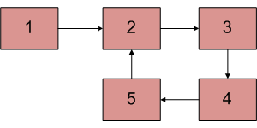
Some dynamic linked data structures
Copyright 2020 Clark Elliott

Slide 53
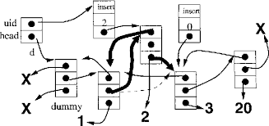
Some dynamic linked data structures
Copyright 2020 Clark Elliott

Slide 54
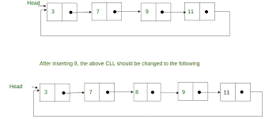
Marshaling a dynamic cyclically linked list
Marshaling process [M] starts marshaling linked object at node 3, completes to 9, App inserts node 8, M completes to 11, now what?
Copyright 2020 Clark Elliott

Slide 55
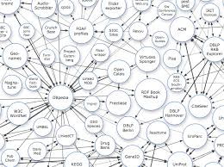
Now write the code to marshal this
Copyright 2020 Clark Elliott

Slide 56
Introspection
Copyright 2020 Clark Elliott
Sometimes objects have information about their class available. This has to be marshaled as well.
Java supports introspection in its serialization
CDR sends only the data and assumes knowledge of the objects.

Slide 57
XML namespaces
Copyright 2020 Clark Elliott
Information about contained objects, but may be in an external reference.
XML namespaces sometimes use URLs as unique strings (UUIDs), and have nicknames within a document.
Any named item in the document with the nickname thus made globally unique.
E.g., “ID_num” can appear in many documents, but is made unique by the docs namespace

Slide 58
Serialization, “flattening”
To store random access memory objects on disk, or to send them on network lines, the process is the same.
Serialization is the process of creating a string of bits, a “series,” to be processed one after another, from a collection of bits that can all be immediately accessed in any order.
Thus all messages, and serialized objects, can also be stored on disk.
This has profound implications for the semantics of time and canonical sinks of data.
Copyright 2020 Clark Elliott

Slide 59
Odd semantics for objects
Copyright 2020 Clark Elliott
Not like the real world.
The object can be written to disk, and then restored in 1,000 years.
The object can be written to disk, and then restored in five new locations every month. Which is the canonical representation?
An object can leave a group, join another group, but still be in the first group. It can return in a different state than the object that did not leave.
An object can be nowhere but later restored.
An object can be half in one location and half in another, during transmission.

Slide 60
CORBA’s CDR
Copyright 2020 Clark Elliott
Common Object Request Broker Architecture, Common Data Represntation
External serial form written, and read, by many different, unlike, platforms.
15 primitive types, plus constructed types
No type information. Sender and Receiver must have prior knowledge. Use IDL?

Slide 61
Figure 4.7 CORBA CDR for constructed types
T
y
p
e
Re
pr
e
s
e
n
ta
t
i
o
n
s
e
q
ue
n
ce
l
e
n
g
th
(
u
n
si
g
n
ed
l
o
n
g
)
fo
ll
ow
ed
b
y
el
e
m
e
nt
s
i
n
o
r
d
e
r
s
t
ri
n
g
l
e
n
g
th
(
u
n
si
g
n
ed
l
o
n
g
)
fo
ll
ow
ed
b
y
ch
a
ra
c
te
rs
i
n o
r
d
e
r
(
ca
n
al
so
ca
n
h
av
e
w
i
de
ch
a
ra
c
te
rs)
a
r
ra
y
a
rr
ay
e
le
m
e
n
t
s i
n
o
r
de
r (
n
o l
en
g
t
h s
p
e
ci
f
ie
d b
eca
us
e
i
t
is
f
i
x
e
d
)
s
t
ru
ct
i
n t
he
or
de
r o
f
de
c
la
r
at
i
o
n o
f
t
he
co
mp
o
n
e
n
t
s
e
n
u
m
e
r
a
t
e
d
u
n
s
i
g
n
e
d
l
o
n
g
(
t
h
e
v
a
l
ue
s a
re
s
pe
c
i
f
ie
d
b
y t
he
o
r
de
r d
ec
l
ar
e
d
)
u
ni
o
n
t
y
p
e
ta
g f
o
l
l
o
we
d b
y
t
h
e s
el
e
cte
d m
e
mb
er

Slide 62
Figure 4.8 CORBA CDR message
index in
notes
sequence of bytes
4 bytes
on representation
0–3
5
length of string
4–7
"Smit"
‘Smith’
8–11
"h___"
12–15
6
length of string
16–19
"Lond"
‘London’
20-23
"on__"
24–27
1934
unsigned long
The flattened form represents a
Person
struct with value: {‘Smith’, ‘London’, 1934}

Slide 63
Java serialization
Copyright 2020 Clark Elliott
When objects refer to other necessary objects, they have to be included as well.
Version checking is performed – often very important in DSes, when services and clients can go off line.
Class information is written, followed by types, and names of instance variables.
References are serialized as handles referring to an object within the serialized form. The object is written just once. Thereafter the object is not written, just the handle.

Slide 64
Figure 4.9 Indication of Java serialized form
Serialized values
Explanation
Person
8-byte version number
h0
class name, version number
int year
java.lang.String
java.lang.String
number, type and name of
3
name:
place:
instance variables
1934
5 Smith
6 London
h1
values of instance variables
The true serialized form contains additional type markers; h0 and h1 are handles

Slide 65
Java serialization
Number of vars, followed by type of vars, followed by value of vars
(Strings preceded by length)
Write out the class information, serialize all other objects it references (unless in the JVM). Handles refer to the other objects in the serialized form. 1-1 correspondence between handles and objects.
Recall: Objects written only once, then use handles.
Copyright 2020 Clark Elliott

Slide 66
Java serialization
To Serialize:
Create instance of ObjectOutputStream
Invoke writeObject method, passing our person object as the argument.
To DeSerialize:
Open an ObjectInputStream on the stream
Use ReadObject method to reconstruct the object.
Copyright 2020 Clark Elliott

Slide 67
Figure 4.10 XML definition of the Person structure
<person id="123456789">
<name>Smith</name>
<place>London</place>
<year>1934</year>
<!-- a comment -->
</person >

Slide 68
Figure 4.11 Illustration of the use of a namespace in the Person structure
<person pers:id="123456789" xmlns:pers = "http://www.cdk4.net/person">
<pers:name> Smith </pers:name>
<pers:place> London </pers:place >
<pers:year> 1934 </pers:year>
</person>

Slide 69
Figure 4.12 An XML schema for the Person structure
<xsd:schema xmlns:xsd = URL of XML schema definitions >
<xsd:element name= "person" type ="personType" />
<xsd:complexType name="personType">
<xsd:sequence>
<xsd:element name = "name" type="xs:string"/>
<xsd:element name = "place" type="xs:string"/>
<xsd:element name = "year" type="xs:positiveInteger"/>
</xsd:sequence>
<xsd:attribute name= "id" type = "xs:positiveInteger"/>
</xsd:complexType>
</xsd:schema>

Slide 70
Figure 4.13 Representation of a remote object reference
32 bits
32 bits
32 bits
32 bits
Internet address
port number
time
object number
interface of
remote object

Slide 71
Figure 4.14 Request-reply communication
Client
Server
doOperation
Request
message
getRequest
select object
(wait)
execute
Reply
method
message
sendReply
(continuation)

Slide 72
Figure 4.15 Operations of the request-reply protocol
public byte[] doOperation (RemoteObjectRef o, int methodId, byte[] arguments)
sends a request message to the remote object and returns the reply.
The arguments specify the remote object, the method to be invoked and the arguments of that method.
public byte[] getRequest ();
acquires a client request via the server port.
public void sendReply (byte[] reply, InetAddress clientHost, int clientPort);
sends the reply message reply to the client at its Internet address and port.

Slide 73
Figure 4.16 Request-reply message structure
messageType
int (0=Request, 1= Reply)
requestId
int
objectReference
RemoteObjectRef
methodId
int or Method
arguments
array of bytes

Slide 74
Figure 4.17 RPC exchange protocols
Name
Messages sent by
Client
Server
Client
R
Request
R
R
Request
Reply
R
R
A
Request
Reply
Acknowledge reply

Slide 75
RRA efficiency tricks
Copyright 2020 Clark Elliott
Piggyback the ack N in the packet for request N+1.
Request number N implicitly acknowledges receipt of reply N-1.
Request number N implicitly acks receipt of all replies up to N-1, but only check at intervals of Q (e.g., every 100 replies). Allows interleaving, so more efficient. Have to pause less often. Requires bigger buffers on the server.
Etc.

Slide 76
RPC exchange protocols
Copyright 2020 Clark Elliott
R cheap and efficient. Use it if you can.
RR if you must get a reply.
RRA if the server needs to get rid of stored replies (saved for resend of expensive processing results).
RRA can usually piggyback A in various ways so almost as efficient as RR.
Add to your toolbox!

Slide 77
Copyright 2020 Clark Elliott

Slide 78
Copyright 2020 Clark Elliott

Slide 79
Copyright 2020 Clark Elliott

Slide 80
Copyright 2020 Clark Elliott

Slide 81
RPC request reply…
Copyright 2020 Clark Elliott
Timeouts – server binding problem – resend from client?
Server discards duplicates? Request identifier needed.
Lost reply: Suppose server has executed request, and sent reply, when duplicate shows up? Must re-execute, or store a history. Strictly idempotent operations? E.g. read or add to a set.

Slide 82
RPC request reply…
Copyright 2020 Clark Elliott
History – may be used when re-transmission is required.
Contains message identifier, and endpoint of client to which it was sent.
Can grow too large.
If clients request only one operation at a time (e.g., synchronous request) can use following request as ack. of previous.

Slide 83
RR-Ack
History need only previous message.
When client terminates, messages get saved. Need time-out, purge.
With RRA, no history need be saved
Acks imply ALL previous replies have been received, so the loss of an ack, followed by another RRA sequence, is automatically handled, and client continues without delay.
Copyright 2020 Clark Elliott

Slide 84
Use TCP for RRA?
Copyright 2020 Clark Elliott
If the request or return values are high, might want to use TCP instead of UDP which has a limit on packet size. TCP streams allow for any size object to be sent.

Slide 85
Figure 4.18 HTTP request message
method
URL or pathname
HTTP version
headers
message body
GET
//www.dcs.qmw.ac.uk/index.html
HTTP/ 1.1

Slide 86
Figure 4.19 HTTP reply message
HTTP version
status code
reason
headers
message body
HTTP/1.1
200
OK
resource data

Slide 87
Figure 4.20 Multicast peer joins a group and sends and receives datagrams
import java.net.*;
import java.io.*;
public class MulticastPeer{
public static void main(String args[]){
// args give message contents & destination multicast group (e.g. "228.5.6.7")
MulticastSocket s =null;
try {
InetAddress group = InetAddress.getByName(args[1]);
s = new MulticastSocket(6789);
s.joinGroup(group);
byte [] m = args[0].getBytes();
DatagramPacket messageOut =
new DatagramPacket(m, m.length, group, 6789);
s.send(messageOut);
// this figure continued on the next slide

Slide 88
Figure 4.20 continued
// get messages from others in group
byte[] buffer = new byte[1000];
for(int i=0; i< 3; i++) {
DatagramPacket messageIn =
new DatagramPacket(buffer, buffer.length);
s.receive(messageIn);
System.out.println("Received:" + new String(messageIn.getData()));
}
s.leaveGroup(group);
}catch (SocketException e){System.out.println("Socket: " + e.getMessage());
}catch (IOException e){System.out.println("IO: " + e.getMessage());}
}finally {if(s != null) s.close();}
}
}

Slide 89
Figure 4.21 Sockets used for datagrams
Sending a message
Receiving a message
s = socket(AF_INET, SOCK_DGRAM, 0)
s = socket(AF_INET, SOCK_DGRAM, 0)
bind(s, ClientAddress)
bind(s, ServerAddress)
sendto(s, "message", ServerAddress)
amount = recvfrom(s, buffer, from)
ServerAddress and ClientAddress are socket addresses

Slide 90
Figure 4.22 Sockets used for streams
Requesting a connection
Listening and accepting a connection
s = socket(AF_INET, SOCK_STREAM,0)
s = socket(AF_INET, SOCK_STREAM,0)
bind(s, ServerAddress);
connect(s, ServerAddress)
listen(s,5);
sNew = accept(s, ClientAddress);
write(s, "message", length)
n = read(sNew, buffer, amount)
ServerAddress and ClientAddress are socket addresses

Slide 91
Cut slides:
Copyright 2020 Clark Elliott

Slide 92
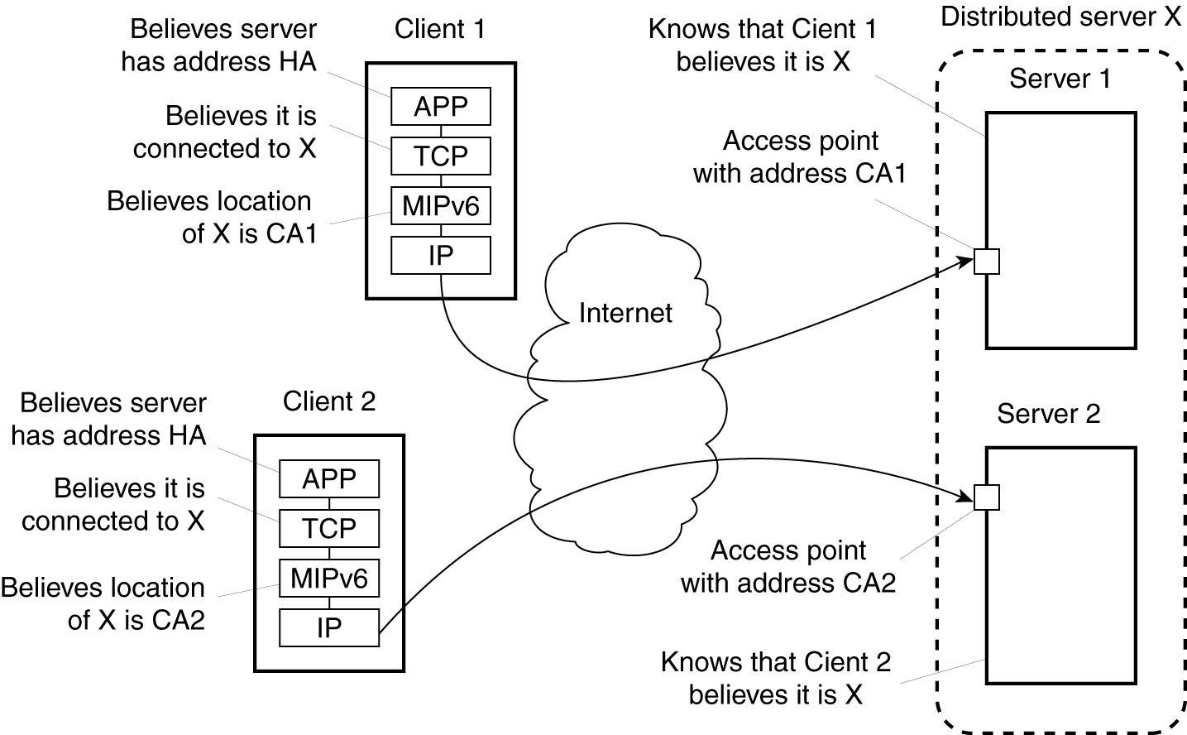
Distributed Servers
Figure 3-14. Route optimization in a distributed server.

Slide 93
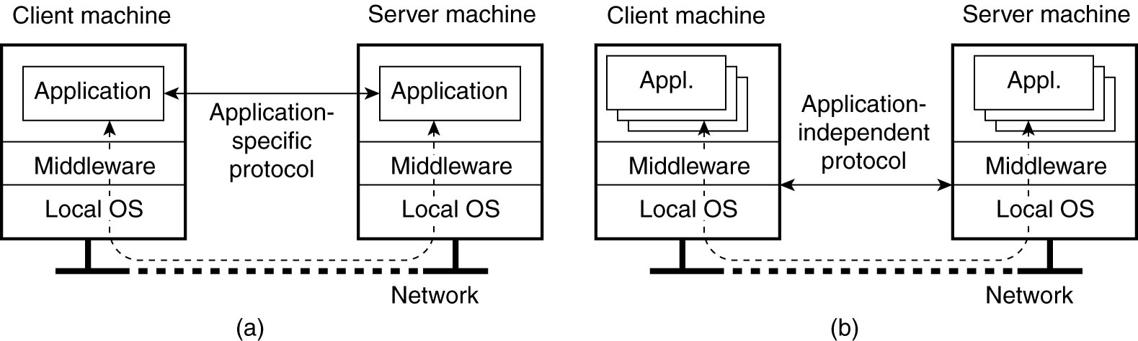
Application level protocol
Figure 3-8. (a) A networked application with its own protocol.

Slide 94
Below the middleware
Figure 3-8. (b) A general solution to allow access
to remote applications.

Slide 95
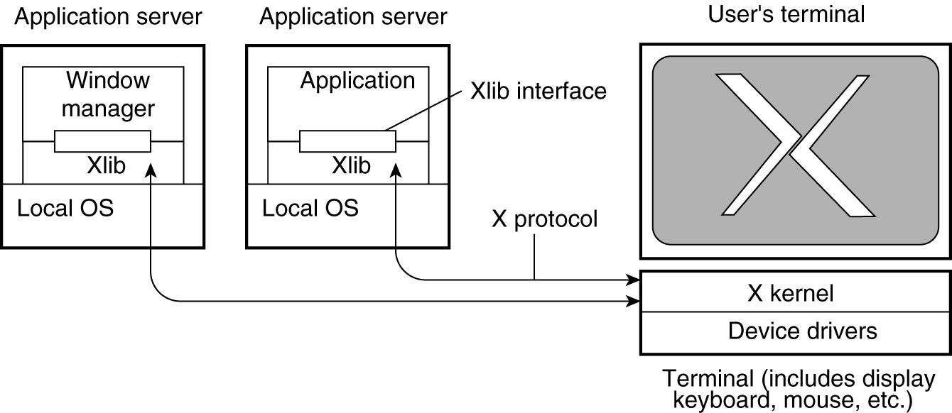
Example: The XWindow System
Figure 3-9. The basic organization of theXWindow System.

Slide 96
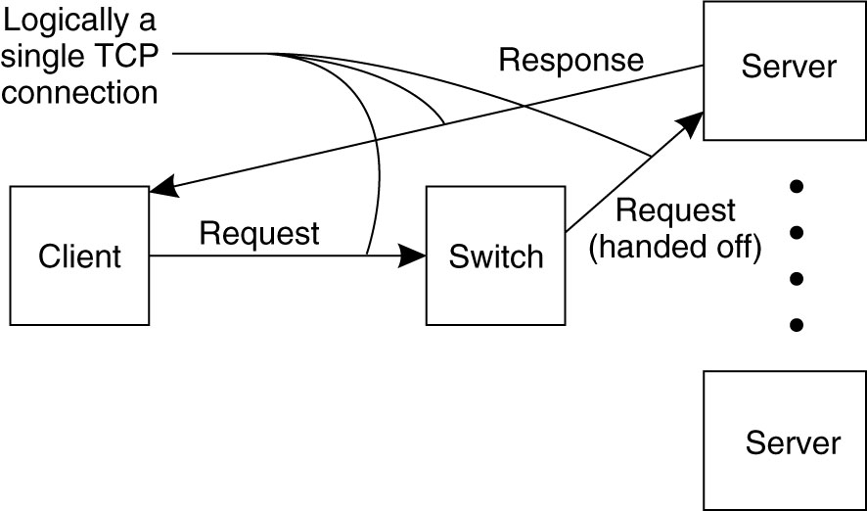
Server Clusters (2)
Figure 3-13. The principle of TCP handoff.

Slide 97
Notes for this undocumented UDP code
Copyright 2020 Clark Elliott
m is message, comes from arg 0
aSocket is opened to server
aHost is server IP address
ServerPort is arbitrary, why not from args?
reply is datagram response
If you play, do yourself a favor and put in messages about processing of requests.

Slide 98
Figure 4.3 UDP client sends a message to the server and gets a reply
import java.net.*;
import java.io.*;
public class UDPClient{
public static void main(String args[]){
// args give message contents and server hostname
DatagramSocket aSocket = null;
try {
aSocket = new DatagramSocket();
byte [] m = args[0].getBytes();
InetAddress aHost = InetAddress.getByName(args[1]);
int serverPort = 6789;
DatagramPacket request = new DatagramPacket(m, args[0].length(), aHost, serverPort);
aSocket.send(request);
byte[] buffer = new byte[1000];
DatagramPacket reply = new DatagramPacket(buffer, buffer.length);
aSocket.receive(reply);
System.out.println("Reply: " + new String(reply.getData()));
}catch (SocketException e){System.out.println("Socket: " + e.getMessage());
}catch (IOException e){System.out.println("IO: " + e.getMessage());}
}finally {if(aSocket != null) aSocket.close();}
}
}

Slide 99
Figure 4.4: UDP server repeatedly receives a request and sends it back to the client
import java.net.*;
import java.io.*;
public class UDPServer{
public static void main(String args[]){
DatagramSocket aSocket = null;
try{
aSocket = new DatagramSocket(6789);
byte[] buffer = new byte[1000];
while(true){
DatagramPacket request = new DatagramPacket(buffer, buffer.length);
aSocket.receive(request);
DatagramPacket reply = new DatagramPacket(request.getData(),
request.getLength(), request.getAddress(), request.getPort());
aSocket.send(reply);
}
}catch (SocketException e){System.out.println("Socket: " + e.getMessage());
}catch (IOException e) {System.out.println("IO: " + e.getMessage());}
}finally {if(aSocket != null) aSocket.close();}
}
}

Slide 100
Figure 4.5: TCP client makes connection to server, sends request and receives reply
import java.net.*;
import java.io.*;
public class TCPClient {
public static void main (String args[]) {
// arguments supply message and hostname of destination
Socket s = null;
try{
int serverPort = 7896;
s = new Socket(args[1], serverPort);
DataInputStream in = new DataInputStream( s.getInputStream());
DataOutputStream out =
new DataOutputStream( s.getOutputStream());
out.writeUTF(args[0]); // UTF is a string encoding see Sn 4.3
String data = in.readUTF();
System.out.println("Received: "+ data) ;
}catch (UnknownHostException e){
System.out.println("Sock:"+e.getMessage());
}catch (EOFException e){System.out.println("EOF:"+e.getMessage());
}catch (IOException e){System.out.println("IO:"+e.getMessage());}
}finally {if(s!=null) try {s.close();}catch (IOException e){System.out.println("close:"+e.getMessage());}}
}
}

Slide 101
Figure 4.6 TCP server makes a connection for each client and then echoes the client’s request
import java.net.*;
import java.io.*;
public class TCPServer {
public static void main (String args[]) {
try{
int serverPort = 7896;
ServerSocket listenSocket = new ServerSocket(serverPort);
while(true) {
Socket clientSocket = listenSocket.accept();
Connection c = new Connection(clientSocket);
}
} catch(IOException e) {System.out.println("Listen :"+e.getMessage());}
}
}
// this figure continues on the next slide

Slide 102
Figure 4.6 continued
class Connection extends Thread {
DataInputStream in;
DataOutputStream out;
Socket clientSocket;
public Connection (Socket aClientSocket) {
try {
clientSocket = aClientSocket;
in = new DataInputStream( clientSocket.getInputStream());
out =new DataOutputStream( clientSocket.getOutputStream());
this.start();
} catch(IOException e) {System.out.println("Connection:"+e.getMessage());}
}
public void run(){
try { // an echo server
String data = in.readUTF();
out.writeUTF(data);
} catch(EOFException e) {System.out.println("EOF:"+e.getMessage());
} catch(IOException e) {System.out.println("IO:"+e.getMessage());}
} finally{ try {clientSocket.close();}catch (IOException e){/*close failed*/}}
}
}

Slide 103
Blank
Copyright 2020 Clark Elliott

